Slide 1
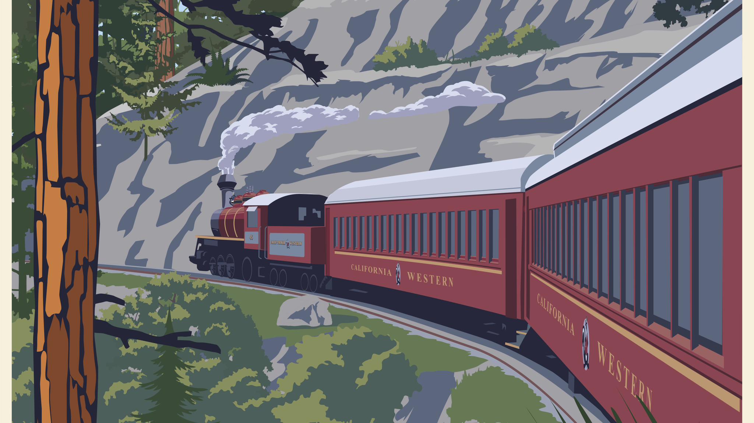
Skunk Train
Demographic Survey
2016-2019

Slide 2
We set out to learn more about our guests.
Here’s a summary of what we found…

Slide 3
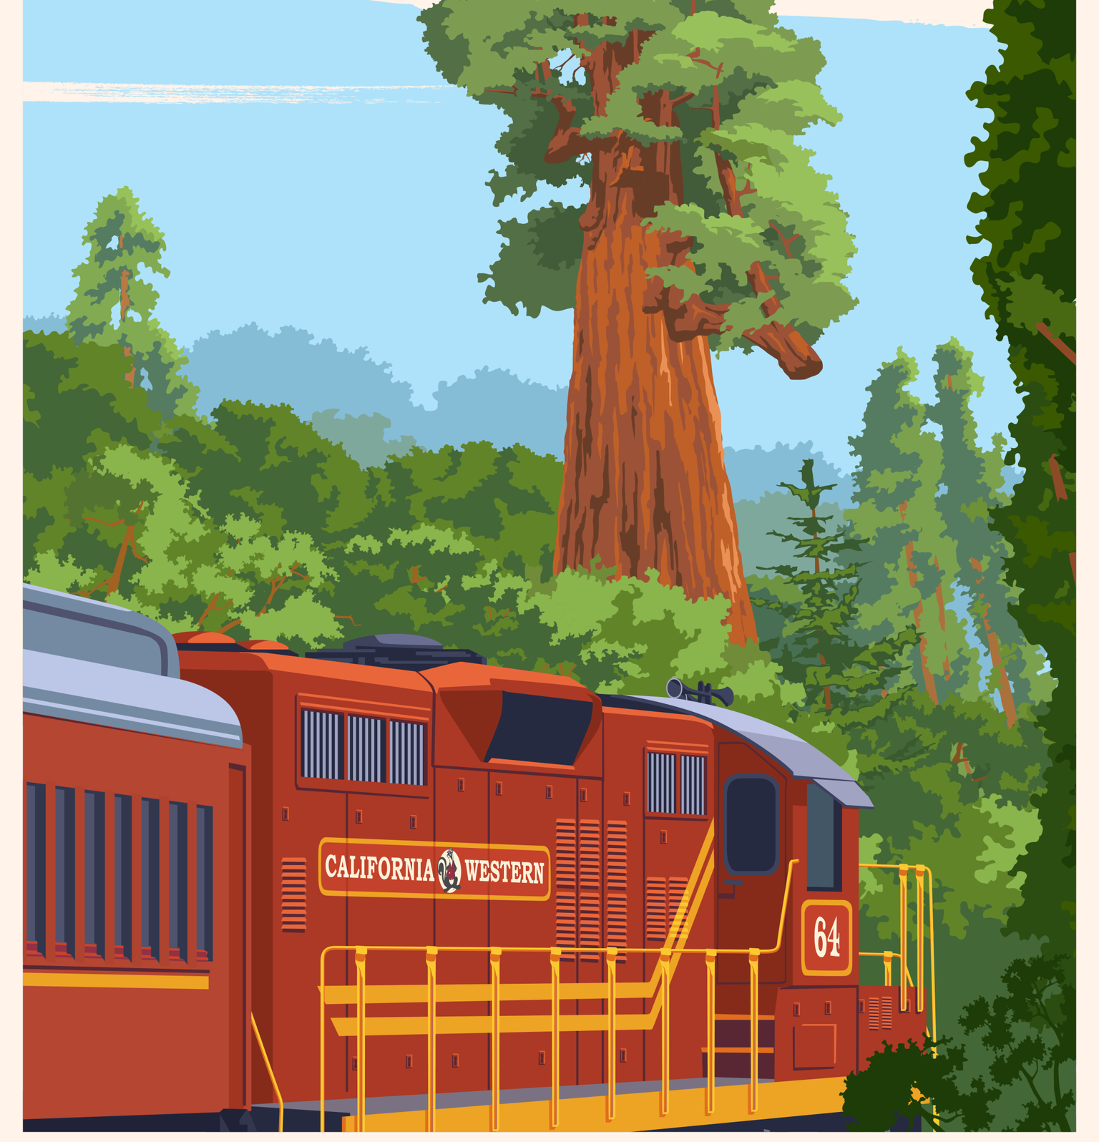
Was this your first visit to the Skunk Train?
2016 2017
69% YES 71% YES
31% NO 29% NO
2018 2019
68% YES 74% YES
32% NO 26% NO

Slide 4
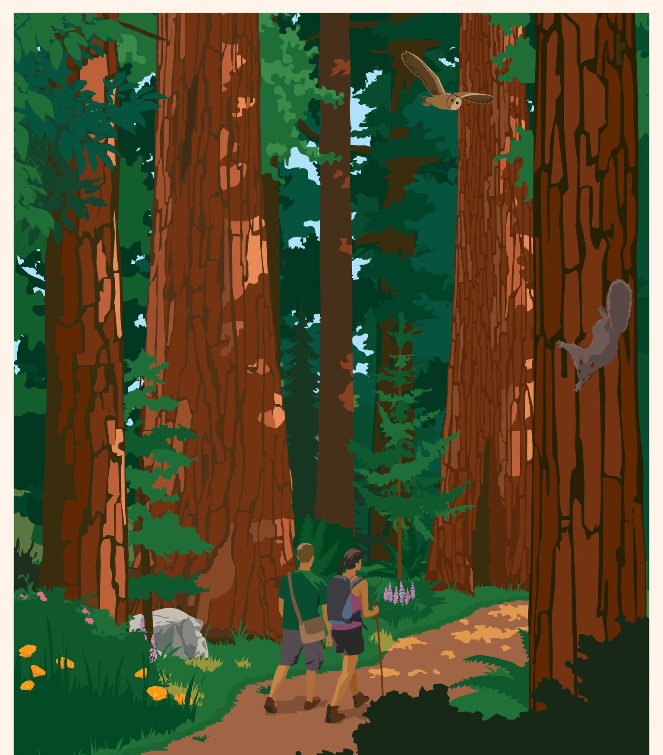
Was the primary purpose of your visit to Mendocino County to ride the Skunk Train?
Was this your first visit to
Mendocino County?
YES NO
2016 31% 69%
2017 34% 66%
2018 30% 70%
2019 33% 67%
YES NO
2016 45% 55%
2017 39% 61%
2018 45% 55%
2019 40% 60%

Slide 5
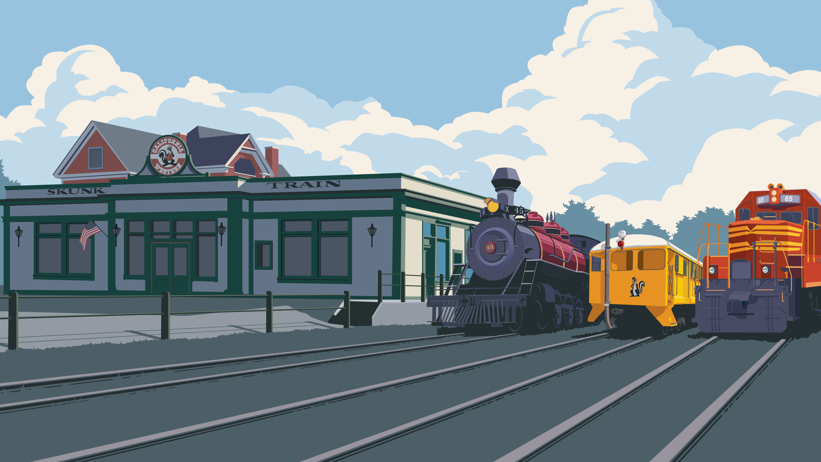
Did you ride from Fort Bragg or Willits?
Fort Bragg
70%
Willits
30%
blended averages (2016-2019)

Slide 6
How did you hear about the Skunk Train?
 | 2019 | 2018 | 2017 | 2016
Word of Mouth (Referrals) | 37% | 47% | 50% | 55%
Search Engine | 17% | 23% | 21% | 20%
Facebook/Instagram | 7% | 3% | 2% | 7%
Brochure or Rack Card | 5% | 7% | 9% | 9%
Print Ad | 1% | 1% | 2% | 1%
Radio Ad | 0% | 0% | 0% | 0%
Media (Newspaper, Magazine, Online Article, Etc.) | 6% | 4% | 9%
VIA | 2% | 4%
101 Things to Do | 3% | 3%
Billboards | 1% | 2%
VisitMendocino.com | 3% | 4% | 4% | 5%
FortBragg.com | 2% | 2% | 3% | 2%

Slide 7
Did you stay overnight?
What type of lodging?
81% YES *
19% NO *
 |  | *
 | Hotel | 30%
 | Motel | 22%
 | Inn | 12%
 | Resort | 3%
 | State Park | 1%
 | Campground | 10%
 | Private Rental | 12%
 | Other | 10%
How many nights?
2.5 *
Where did you stay?
 | 2019 | 2018 | 2017 | 2016
Fort Bragg | 49% | 48% | 46% | 42%
Mendocino Area | 21% | 19% | 18% | 15%
Willits | 3% | 3% | 16% | 23%
Ukiah | 10% | 15% | 4% | 4%
South Coast (Elk to Gualala) | 4% | 3% | 4% | 3%
Other | 13% | 12% | 12% | 13%
* blended averages (2016-2019)

Slide 8
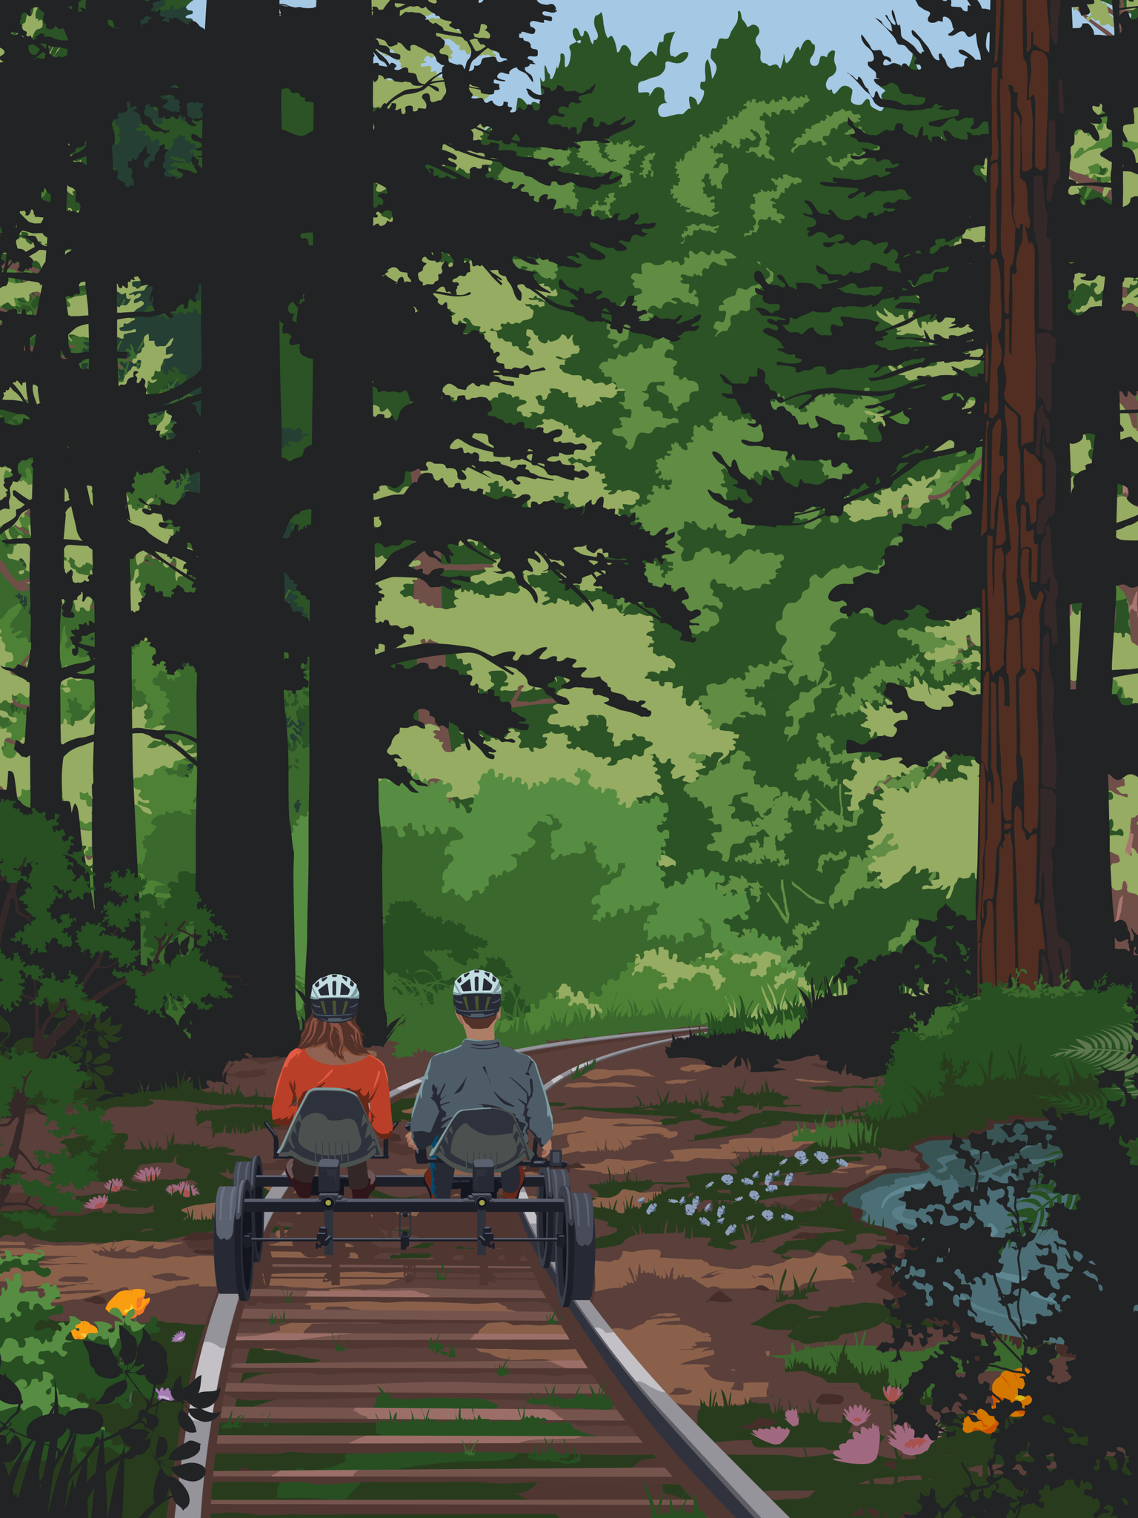
What’s your age?
 |  | *
 | 18-24 | 1%
 | 25-34 | 12%
 | 35-44 | 23%
 | 45-54 | 20%
 | 55-64 | 24%
 | 65-74 | 18%
 | 75 or Older | 3%
How many in your party?
Average party size 3.70 *
How much did you spend?
2019 | 2018 | 2017 | 2016
$655 | $592 | $601 | $733
* blended averages (2016-2019)

Slide 9
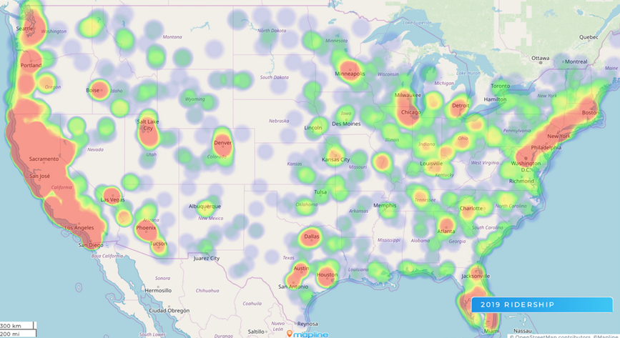

Slide 11
The power of the Skunk
241,000* guests carried.
If the average party was 3.70* people, we saw 65,135 parties.
If the average night stay was 2.5* and 81%* (52,759 parties) stayed, that means passengers on the Skunk Train stayed 131,898 room nights.
If the average party spent $645* that means over $42m was generated for our communities.
With 42%* of guests coming to Mendocino County for just for the Skunk Train, the Skunk directly created 55,397 room nights and $17.6m in spending.
* total or blended averages (2016-2019)

