Slide 1
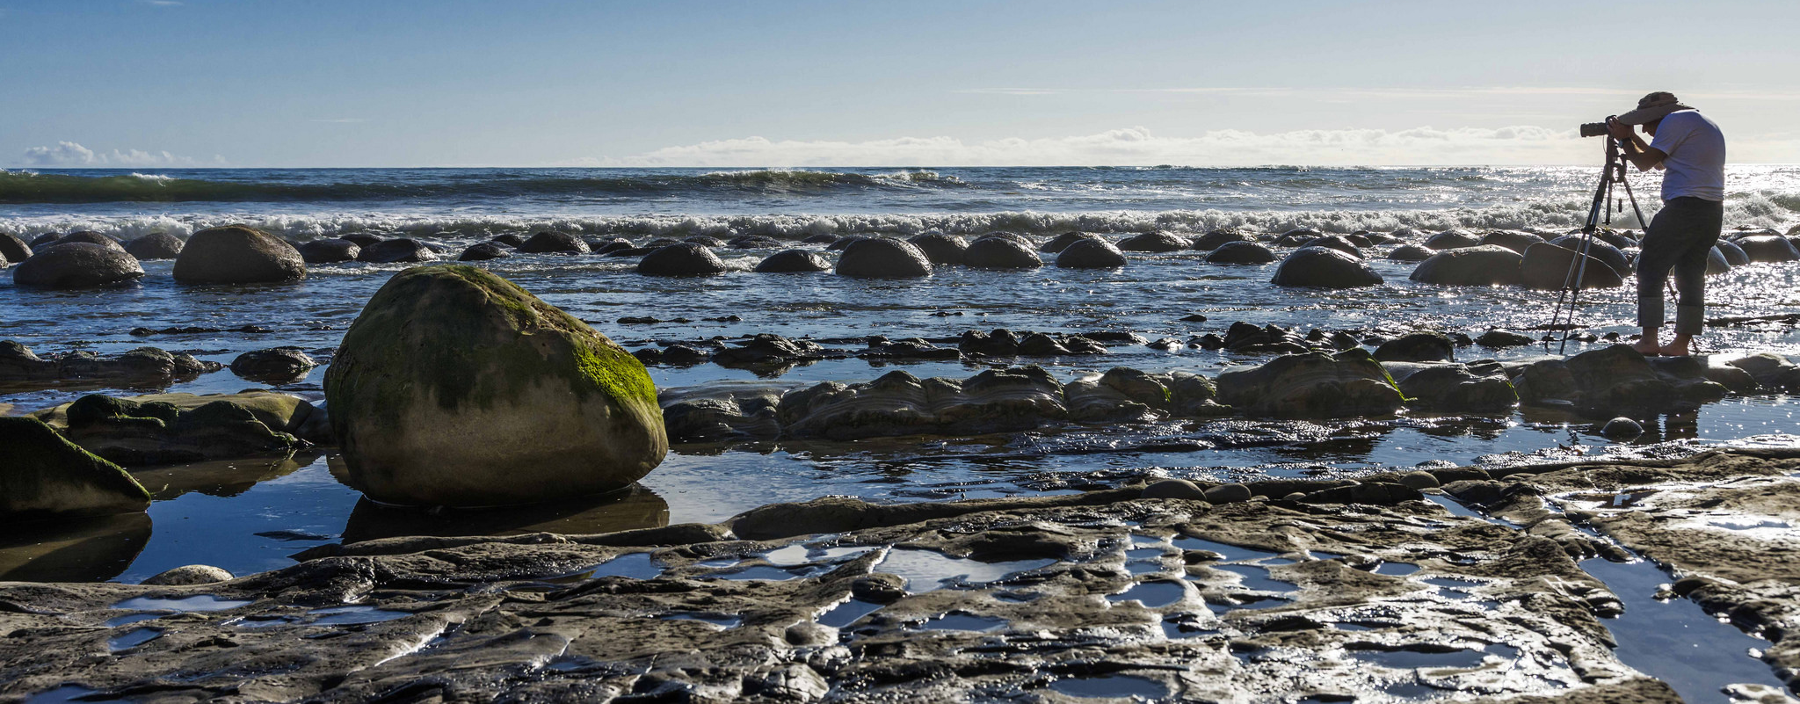
Visit Mendocino County: Strategic Planning
October 12, 2016

Slide 2
About Coraggio Group

Slide 3
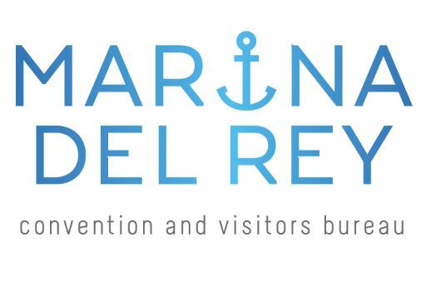
Destination Marketing Experience

Slide 4
Coraggio’s Strategic Clarity Framework
clarity
focus
action
vision
mission
values
brand
position
imperatives
objectives
initiatives

Slide 5
Stakeholder Engagement

Slide 6
Santa Monica CVB: Strategic Direction 2013/14-2017/18
Vision Santa Monica is the premier beach-city destination in the world.
Mission To increase visitor expenditures, tourism revenue and local employment opportunities through promotion of Santa Monica as a travel destination.
Values We will cultivate an inspiring team culture that fosters creative and enthusiastic individuals who elevate the SM experience through collaboration and expert leadership.
Leadership & Expertise | Creativity | Collaboration | Enthusiasm
Brand Intention
Effective | Creative
Strategic | Bold | Caring
Authentic | Professional
Position SMCVB is the dedicated tourism resource and brand manager for Santa Monica that delivers vital benefits to a diverse group of stakeholders.
Clarity
Imperatives
Objectives
Initiatives
Drive balanced demand for the destination.
Establish and maintain a stable year-round occupancy.
Maintain consistent y/y majority of int’l visitors.
Grow y/y average visitor spend.
Maintain or increase y/y average length of stay.
Maximize domestic travel from target markets.
Maximize international travel from target markets.
Convert day visitors to overnight visitors.
Increase length of stay of day visitors.
Increase overall spend.
Enhance the brand and steward the destination experience.
Maintain minimum favorable impression of the destination’s brand.
Maintain y/y CVB-generated media placements in target markets and publications that highlight intended messaging.
Expand and manage our digital reach.
Ensure minimum average overall brand delivery score of 4 by 2015/16.
Clarify long-term brand position.
Improve destination brand impression.
Develop improved brand management tools.
Build upon quality media placements and relationships.
Optimize and manage digital presence.
Actively champion the value of tourism.
Ensure consistent delivery on annual and quarterly economic impact, brand strength and revenue generation.
Ensure minimum net favorability rating of X% by Santa Monica community by 2017/18.
Maximize Board’s proactive involvement in advocating for SMCVB, tourism and on behalf of the industry.
Position the destination and the CVB as a leader in the industry.
Strengthen Board engagement.
Improve information dissemination.
Raise awareness among SM residents on the value of tourism.
Position SM and CVB as an innovative industry leader.
Focus
Action
Strengthen strategic partnerships and relationships.
Increase alliance partnerships’ target assortments.
Increase stakeholder support as measured by in-kind, fair share and engagement.
Increase the number of qualified client relationships.
Optimize process for determining CVB support of/for community events, initiatives and projects.
Evaluate and streamline offerings to current and potential alliance partners.
Maximize number of qualified client relationships.
Develop decision criteria for determining CVB support for community events, initiatives and projects.
Ensure operational excellence.
Operational
Limit administrative expenses to industry standards and as required by Tourism Marketing District.
Ensure data accuracy as measured by our audit, data base, reporting, website.
Culture
Ensure minimum of 90% employee satisfaction on key measures.
Continually identify professional development opportunities for all staff.
Structure and develop the organization to deliver the most value back to the community.
Optimize our method of data capture and reporting methodology.
Implement a plan to ensure a strong and stable workforce.

Slide 7
Questions?

