Slide 1
Mendocino Tourism
October 2016

Slide 2
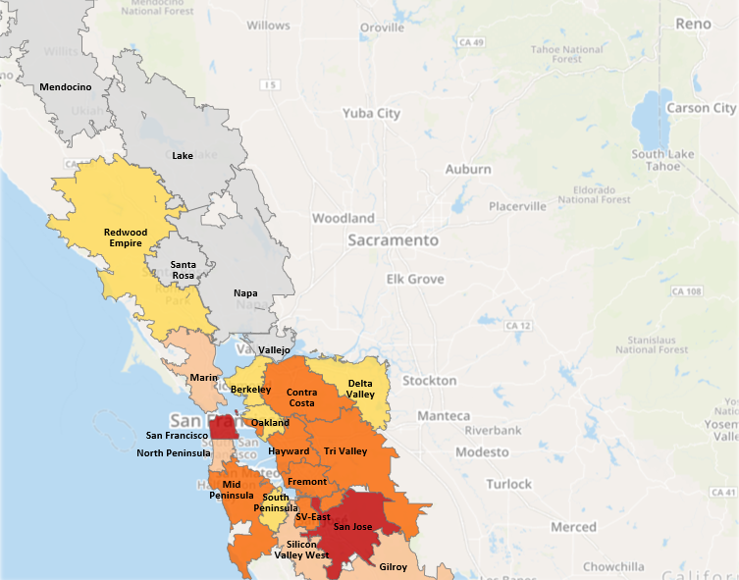
Household Income $100k+
Density of Your Target Market by Zone
38%
of Bay Area adults have a HH Income of $100,000+
 | Zone | Target Persons | Density of Target
 | San Francisco | 301,237 | 13.7%
 | San Jose | 277,837 | 12.7%
 | Contra Costa | 180,255 | 8.2%
 | Hayward | 140,293 | 6.4%
 | Mid Peninsula | 135,713 | 6.2%
 | Fremont | 121,489 | 5.5%
 | Silicon Valley East | 119,326 | 5.4%
 | Tri-Valley | 106,520 | 4.9%
 | Silicon Valley West | 85,326 | 3.9%
 | Gilroy | 84,444 | 3.8%
 | Marin | 82,926 | 3.8%
 | North Peninsula | 79,927 | 3.6%
 | Berkeley | 74,087 | 3.4%
 | Oakland | 70,697 | 3.2%
 | Redwood Empire | 70,186 | 3.2%
 | Delta Valley | 68,486 | 3.1%
 | South Peninsula | 65,645 | 3.0%
 | Santa Rosa | 52,636 | 2.4%
 | Napa | 45,963 | 2.1%
 | Vallejo | 25,027 | 1.1%
 | Lake | 5,032 | 0.2%
 | Mendocino | 2,881 | 0.1%
 | Total | 2,195,933 | 100%
Source: Nielsen Scarborough, San Francisco DMA, Aug ‘14-Jul ‘15. Base:18+. Target: HH Income = $100k+/Year.

Slide 3
Household Income $100k+
Density of Your Target Market by Zone
 | Zone | Total Number of Target Persons | Density of Target
 | El Dorado | 54,550 | 48%
 | Vacaville | 31,863 | 35%
 | Roseville | 32,927 | 33%
 | Tracy | 22,458 | 33%
 | Rocklin | 34,462 | 31%
 | Manteca | 19,401 | 27%
 | Grass Valley | 16,999 | 24%
 | Auburn / LOP | 15,060 | 24%
 | West Sacramento | 28,243 | 23%
 | Folsom | 45,687 | 22%
 | Elk Grove | 74,212 | 22%
 | Davis | 12,804 | 22%
 | Foothills | 8,329 | 19%
 | Downtown Sac | 55,952 | 19%
 | Fairfield | 21,809 | 19%
 | Turlock | 35,332 | 18%
 | Sonora | 6,890 | 16%
 | Citrus Heights | 41,788 | 15%
 | Lodi | 7,661 | 15%
 | Modesto | 30,114 | 13%
 | Yuba City | 16,962 | 13%
 | Stockton | 32,705 | 11%
 | Total | 646,208
Grass Valley
Yuba City
Auburn
Rocklin
West Sacramento
Roseville
El Dorado
CH
Dwtn.
Sac
Davis
Folsom
Vacaville
Elk Grove
Fairfield
Vacaville
Lodi
Foothills
Stockton
Sonora
Manteca
Turlock
Tracy
Turlock
Modesto
How to Read:
48% of adults living in the El Dorado Zone have a HH Income of $100K+, equaling 54,550 total people in the El Dorado Zone.
Source: Nielsen Scarborough Data, SAC DMA. Release 1, 2016. Base: A18+. Target: Household Income: $100k+. Extrapolated by Rhiza.

Slide 4
Visit Mendocino Schedule
San Francisco
Zones | Dates | Networks | # of Spots | Investment (Gross)
Berkeley, Contra Costa, AT&T Zones A25-54, Rch: 36.3%, Freq: 2.3 | December 2016 through February 2017 |  | 2,574 | $12,142.00
Regional Sports Network
Zones | Dates | Networks | # of Spots | Investment (Gross)
DirecTV and Dish Regional Sports Network Zones San Francisco, Sacramento, Fresno, Monterey-Salinas-Santa Cruz | November 2016 through March 2017 |  | 12 | $4,800.00
Sacramento
Zones | Dates | Networks | # of Spots | Investment (Gross)
West Sacramento, AT&T Zone A25-54, Rch: 62.9%, Freq: 3.4 | December 2016 through February 2017 |  | 1,794 | $5,791.50
Authorized Signature: _______________________________ Date: ______________

Slide 5
Investment Summary
DEC 2016- FEB 2017
San Francisco DMA Audience Targeted In-Stream
Recommended Target: Travel Intenders
TOTAL INVESTMENT : $10,000 | TOTAL IMPRESSIONS: 285,714
* May be cancelled with 2 weeks written notice. **Sample of In-Stream Sites

Slide 6
VIRGINIA BEACH CONVENTION
AND VISITORS BUREAU
OVERVIEW:
Vacations have a way of helping families reconnect and create lifelong memories. Tapping into that powerful emotional connection was the objective of a multi-screen advertising campaign from the Virginia Beach Convention and Visitors Bureau (VBCVB). Their “love the moment” theme portrayed the types of little moments that resonated with their target audience of adults 35-54 with families, and a household income of $85,000+. Secondarily, the VBCVB was looking to reach an audience of “baby boomers” and couples. It wasn’t just a multi-screen campaign, it was a multi-city campaign as well, including Washington D.C., Baltimore, Philadelphia, New York, Pittsburgh, Richmond, Roanoke and Harrisburg..
STRATEGY:
The VBVCB used video-on-demand (VOD), cable television and online advertising to create a balance of broad and highly focused messaging to maximize reach and effectiveness. They began the campaign with several specific goals in mind:
Increasing website visits by 10% year-over-year.
Achieving more than 50,000 unique visits to a campaign-specific microsite.
Increase year-over-year performance in click-through and interaction rates.
On XFINITY.com, the agency combined exposure on the site’s entertainment, sign-in, mail center and home pages. The advertising worked in tandem with their VOD and cable messages to increase awareness of the Virginia Beach destination.
SUCCESS:
Website visits increased 20% year-over-year (surpassing goal of 10%), with unique visitors up 21% and page views up 18%.
Campaign-specific microsite had more than 100,000 viewers and 95,000 unique visitors (surpassing goal of 50,000).
Average interaction rate for XFINITY.com advertising of 3.37% and click-through rate of .12%.
Succeed on screen

Slide 7
BENZIE COUNTY VISITORS BUREAU SUCCESS STORY
CHICAGO, IL
OVERVIEW:
The Benzie County Visitors Bureau, in Benzonia, MI, faced a common challenge in promoting tourism in Northern Michigan: stretching a modest budget to reach a large target audience. The Bureau had developed three television commercials and a custom website featured in those commercials to track their effectiveness.
STRATEGY:
Comcast Spotlight worked with the bureau to create a cost-effective, integrated television and online media plan to reach several markets. Advertising was focused on networks that best matched their target demographic, including Bravo, Discovery, TLC, TNT, Travel Channel, A&E, FOX News, ABC Family, USA and Xfinity.com.
Additional digital marketing efforts included a YouTube page where the commercials were featured, and links to those videos on the Benzie County Visitors Bureau home page, Facebook page and on individual bureau members’ websites.
SUCCESS:
Website traffic increased 53%.
Requests for visitors’ guides increased 69%.
Custom-designed website saw immediate traffic and click-throughs to primary website immediately after campaign launch.
Succeed on screen

Slide 8
Berkeley syscodes 5542 & 4180 TV & Online Advertising Area Profile
Cable TV Households*
Available Networks
75,269
Demographic Profile
Age Groups
Persons 17 and under | 20.0%
Adults 18-34 | 29.0%
Adults 35-54 | 26.1%
Adults 55+ | 24.9%
Education
Attended/Graduated College/Post Graduate | 69.8%
Marital Status
Single (Never Married) | 41.7%
Married | 38.7%
Divorced/Separated/Widowed | 19.6%
Household Income
$30,000-$49,999 | 14.8%
$50,000-$74,999 | 16.4%
$75,000-$99,999 | 12.5%
$100,000+ | 31.4%
Housing Units & Family Type
% Owner Occupied Units | 48.9%
% of HH with Children | 30.3%
Race
White | 53.9%
Asian | 19.6%
Black/African American | 14.4%
Other | 12.1%
Ethnicity
Hispanic | 24.9%
Exclusive Xfinity Networks
Communities Served
Note: Communities served may vary for Telco households
Albany
Berkeley
Crockett
El Cerrito
El Sobrante
Hercules
Kensington
Pinole
Port Costa
Richmond
Rodeo
San Pablo
*Internal Comcast Spotlight subscriber counts, Q1 2015, adjusted to Nielsen FF Interconnect universe estimates, San Francisco DMA, February 2015.
Source: 2013 American Community Survey, United States Census Bureau: 2013, Added to Rhiza for Media: 2015-02-06. Note: Marital Status Base = Adults 15+, Education Base = Adults 25+. Percentages may not add to 100% due to rounding.
* DISCLOSURES: The number of subscribing homes receiving advertisements on any cable network is an estimate and may vary by geographic areas and other factors. Any statement of (1) the number of subscribing homes receiving an advertisement and (2) audience estimates are based either on the NCC methodology which utilizes either Nielsen carriage & insertion Universe Estimates or adjusts internal carriage/insertion sub counts by the Nielsen full footprint Interconnect Universe Estimate. Zone estimates are generated by using Nielsen Interconnect Universe Estimates, adjusted on a pro rata basis by internal subscriber counts by zone. Estimates may contain impressions outside the home DMA. The number of homes capable of accessing VOD and interactive TV advertising content is an estimate and may vary by the number of homes actually subscribing to digital cable service and other factors. Current Nielsen audience reporting methodology does not provide the ability to adjust audience estimates for HD simulcast programming for non-insertion. The company may not have the capability to insert on HD simulcast networks or to enable interactive overlays on HD simulcast networks. For more information please contact your Advertising Sales Executive.

Slide 9
Contra Costa Plus syscode 9422 Advertising Area Profile
Cable TV Households*
Available Networks
19,210
Demographic Profile
Age Groups
Persons 17 and under | 21.6%
Adults 18-34 | 21.2%
Adults 35-54 | 28.3%
Adults 55+ | 28.9%
Education
Attended/Graduated College/Post Graduate | 71.7%
Marital Status
Single (Never Married) | 29.3%
Married | 49.0%
Divorced/Separated/Widowed | 21.7%
Household Income
$30,000-$49,999 | 14.8%
$50,000-$74,999 | 17.7%
$75,000-$99,999 | 12.5%
$100,000+ | 35.9%
Housing Units & Family Type
% Owner Occupied Units | 59.9%
% of HH with Children | 30.9%
Race
White | 73.5%
Asian | 11.6%
Black/African American | 3.2%
Other | 11.7%
Ethnicity
Hispanic | 22.4%
Communities Served
Concord
Walnut Creek
Clyde
Comcast Spotlight is proud to be the Representative for Wave Broadband
Ad Sales
*Internal Comcast Spotlight subscriber counts, Q1 2015, adjusted to Nielsen FF Interconnect universe estimates, San Francisco DMA, February 2015.
Source: 2013 American Community Survey, United States Census Bureau: 2013, Added to Rhiza for Media: 2015-02-06. Note: Marital Status Base = Adults 15+, Education Base = Adults 25+. Percentages may not add to 100% due to rounding.
* DISCLOSURES: The number of subscribing homes receiving advertisements on any cable network is an estimate and may vary by geographic areas and other factors. Any statement of (1) the number of subscribing homes receiving an advertisement and (2) audience estimates are based either on the NCC methodology which utilizes either Nielsen carriage & insertion Universe Estimates or adjusts internal carriage/insertion sub counts by the Nielsen full footprint Interconnect Universe Estimate. Zone estimates are generated by using Nielsen Interconnect Universe Estimates, adjusted on a pro rata basis by internal subscriber counts by zone. Estimates may contain impressions outside the home DMA. The number of homes capable of accessing VOD and interactive TV advertising content is an estimate and may vary by the number of homes actually subscribing to digital cable service and other factors. Current Nielsen audience reporting methodology does not provide the ability to adjust audience estimates for HD simulcast programming for non-insertion. The company may not have the capability to insert on HD simulcast networks or to enable interactive overlays on HD simulcast networks. For more information please contact your Advertising Sales Executive.

Slide 10
Contra Costa syscodes 5262 & 4181 TV & Online Advertising Area Profile
Cable TV Households*
Cable TV Households*
Available Networks
117,792
Demographic Profile
Age Groups
Persons 17 and under | 22.2%
Adults 18-34 | 18.4%
Adults 35-54 | 29.6%
Adults 55+ | 29.8%
Education
Attended/Graduated College/Post Graduate | 78.7%
Marital Status
Single (Never Married) | 27.1%
Married | 53.2%
Divorced/Separated/Widowed | 19.7%
Household Income
$30,000-$49,999 | 12.4%
$50,000-$74,999 | 15.1%
$75,000-$99,999 | 11.6%
$100,000+ | 45.6%
Housing Units & Family Type
% Owner Occupied Units | 65.4%
% of HH with Children | 32.0%
Race
White | 76.5%
Asian | 12.0%
Black/African American | 2.6%
Other | 8.8%
Ethnicity
Hispanic | 15.2%
Exclusive Xfinity Networks
Communities Served
Note: Communities served may vary for Telco households
Alamo
Blackhawk
Clayton
Concord
Danville
Diablo
Lafayette
Martinez
Moraga
Orinda
Pacheco
Pleasant Hill
Rossmoor
Walnut Creek
*Internal Comcast Spotlight subscriber counts, Q1 2015, adjusted to Nielsen FF Interconnect universe estimates, San Francisco DMA, February 2015.
Source: 2013 American Community Survey, United States Census Bureau: 2013, Added to Rhiza for Media: 2015-02-06. Note: Marital Status Base = Adults 15+, Education Base = Adults 25+. Percentages may not add to 100% due to rounding.
* DISCLOSURES: The number of subscribing homes receiving advertisements on any cable network is an estimate and may vary by geographic areas and other factors. Any statement of (1) the number of subscribing homes receiving an advertisement and (2) audience estimates are based either on the NCC methodology which utilizes either Nielsen carriage & insertion Universe Estimates or adjusts internal carriage/insertion sub counts by the Nielsen full footprint Interconnect Universe Estimate. Zone estimates are generated by using Nielsen Interconnect Universe Estimates, adjusted on a pro rata basis by internal subscriber counts by zone. Estimates may contain impressions outside the home DMA. The number of homes capable of accessing VOD and interactive TV advertising content is an estimate and may vary by the number of homes actually subscribing to digital cable service and other factors. Current Nielsen audience reporting methodology does not provide the ability to adjust audience estimates for HD simulcast programming for non-insertion. The company may not have the capability to insert on HD simulcast networks or to enable interactive overlays on HD simulcast networks. For more information please contact your Advertising Sales Executive.

Slide 11
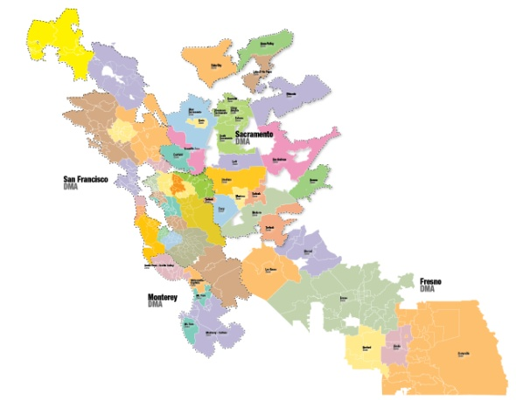
DISH-DIRECTV Satellite Zone Profile for Regional Sports Nets (RSNs)
San Francisco DMA DISH-DTV RSN HHs*
562,321
Demographic Profile
Available Networks
Age Groups
Adults 18-34 | 26.8%
Adults 35-54 | 40.9%
Adults 55+ | 32.2%
Education
Attended/Graduated College/Post Graduate | 66.8%
Marital Status
Single (Never Married) | 29.0%
Married | 60.6%
Divorced/Separated/Widowed | 10.4%
Household Income
$30,000-$49,999 | 18.0%
$50,000-$74,999 | 14.0%
$75,000-$99,999 | 15.1%
$100,000+ | 41.3%
Housing Units & Family Type
% Owner Occupied Units | 67.1%
% of HH with Children | 40.6%
Race
White | 75.2%
Asian | 7.6%
Black/African American | 4.8%
Other | 12.4%
Ethnicity
Hispanic | 26.6%
CSN Bay Area
CSN California
DMA’s SERVED
San Francisco
Sacramento
Fresno
Monterey-Salinas-Santa Cruz
Outside of Market CSN subscribers
* Satellite HHs and viewing in additional DMA’s covering greater Northern California not included in the SF DMA sub counts
DISH-DIRECTV Network Q1 2015 RSN Carriage Inputs, Subscriber count is for SF DMA only.
Source: Nielsen Scarborough, San Francisco, Release 2, 2014. Demo: Adults 18+; Target: (Satellite TV Program Provider-HH: DIRECTV OR DISH) AND (HH Owns/ Uses DVR-Digital Video Rec: Yes).

Slide 12
West Sacramento syscodes 6076 & 4235 Advertising Area Profile
Demographic Profile
Available Networks
Age Groups
Persons 17 and under | 26.0%
Adults 18-34 | 24.4%
Adults 35-54 | 27.1%
Adults 55+ | 22.4%
Education
Attended/Graduated College/Post Graduate | 56.0%
Marital Status
Single (Never Married) | 30.9%
Married | 47.5%
Divorced/Separated/Widowed | 21.6%
Household Income
$30,000-$49,999 | 18.5%
$50,000-$74,999 | 17.8%
$75,000-$99,999 | 13.1%
$100,000+ | 24.6%
Housing Units & Family Type
% Owner Occupied Units | 54.0%
% of HH with Children | 39.1%
Race
White | 69.9%
Asian | 6.6%
Black/African American | 2.6%
Other | 20.8%
Ethnicity
Hispanic | 40.7%
Communities Served
Dixon
West Sacramento
Winters
Woodland
Comcast Spotlight is proud to be the Representative for
Wave Broadband Ad Sales
Source: 2013 American Community Survey, United States Census Bureau: 2013, Added to Rhiza for Media: 2015-02-06. Note: Marital Status Base = Adults 15+, Education Base = Adults 25+. Percentages may not add to 100% due to rounding.

